Slide 1
Line story
Zara is doing her sprint training.
This graph shows how her distance changes during one run.
50
40
30
Distance from start / m
20
10
0
0
2
4
6
8
10
12
14
16
18
20
Time / s

Slide 2
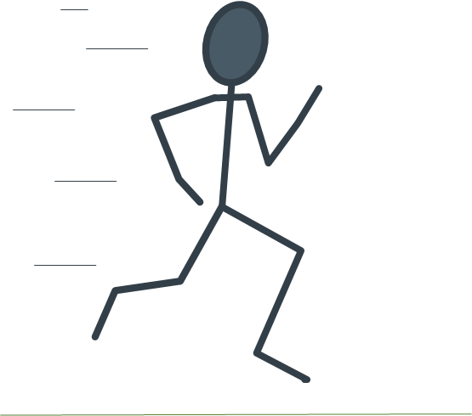
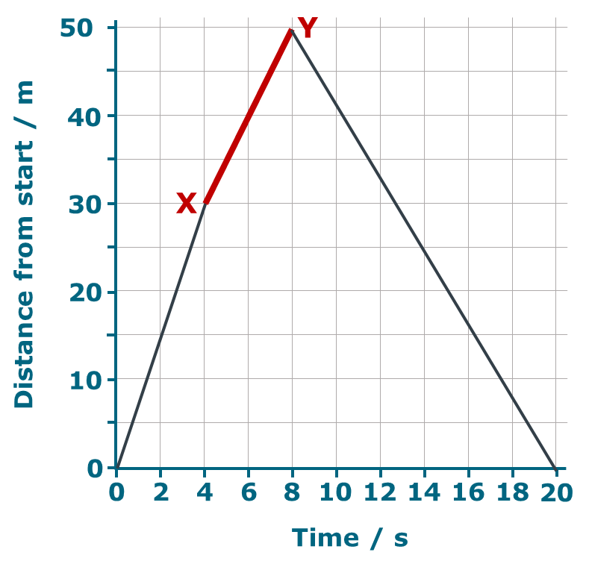
Line story
What does the part of the graph between X and Y
tell you about Zara?
Pick the best description.
A
She climbs a 20m hill
B
She runs 50m
C
She runs 20m in 8 seconds
D
She runs 20m in 4 seconds

Slide 3
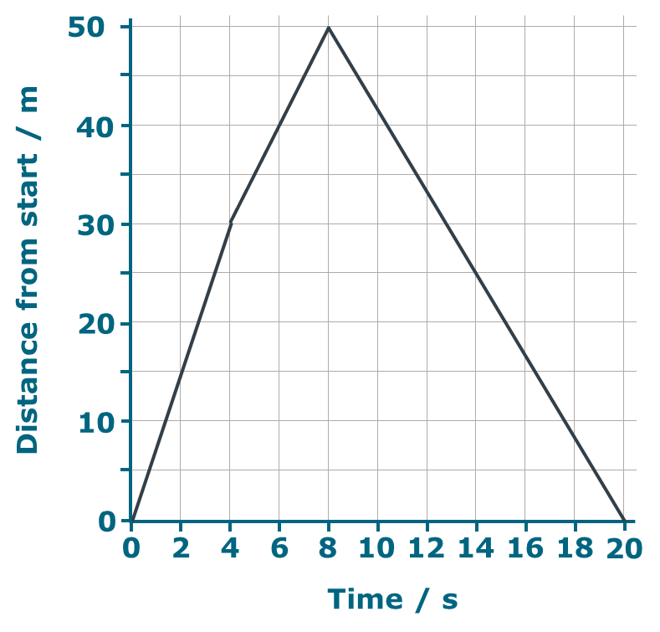
Line story
Where is Zara when she reaches
the point marked Z?
A
Back to the start
B
50m from the start
C
100m from the start
Z
D
You can’t tell

